Slide 1


GOODCABS Transportation & Mobility System
Performance evaluation of Goodcabs operations across ten Indian tier-2 cities, focusing on growth, passenger loyalty, and service excellence to achieve 2024 strategic target
Presented by Karan Singh Rawat

Slide 2

Agenda :
Problem Statement
Project Objective
Dataset Overview
Primary & Secondary Analysis
Ad-hoc Requests
Dashboard View
Recommendations

Slide 3

Problem Statement
Goodcabs, a cab service company established 2 years ago, has gained a strong foothold in the Indian market by focusing on tier-2 cities. Unlike other cab services providers, Goodcabs is committed to supporting local drivers, helping them make a sustainable living in their hometowns, while ensuring excellent services to passengers. With operations in ten tier-2 cities across India. Goodcabs has set ambitious performance target for 2024 to drive growth and improve passenger satisfaction.

Slide 4
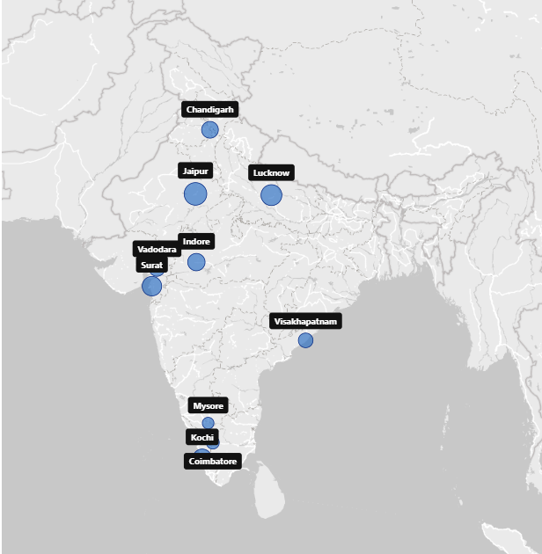
GoodCabs Operating Cities
Chandigarh
Coimbatore
Indore
Jaipur
Kochi
Lucknow
Mysore
Surat
Vadodara
Visakhapatnam

Slide 5

Project Objective :
1. Trip Performance Insights
2. Passenger Satisfaction Evaluation
3. Repeat vs New Passenger Analysis
4. Trip Distribution Across City Category
5. Operational Efficiency Tracking
6. Strategic Recommendations for the Goodcabs

Slide 6
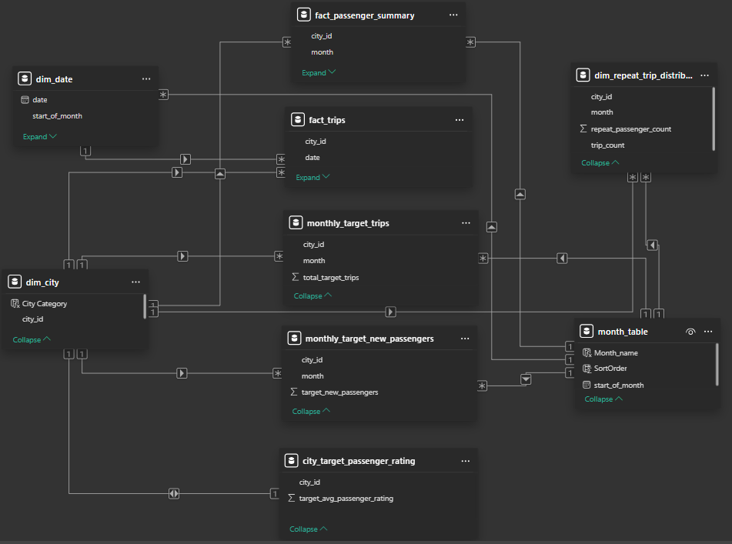
Dataset View
Data Tables :
fact_trips
fact_passenger_summary
dim_date
dim_city
dim_repeat_trip_distribution
monthly_target_trips
monthly_target_new_passengers
city_target_passenger_rating
Also 2 SQL databases for ad-hoc requests solution
targets_db
trips_db

Slide 7


Primary Analysis

Slide 8
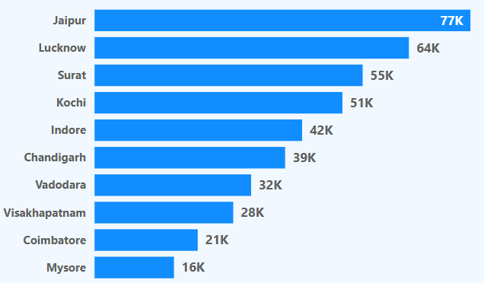
PA -1
Identify Top 3 & Bottom 3 City by total trips based on entire analysis Period
Top 3 Cities by trip Volume
Jaipur : 77k (18.12%) – driven by tourism
Lucknow : 64k(15.06%)
Surat : 55k(12.94%)
Bottom 3 Cities by trip volume
Mysore : 16K(3.76%)
Coimbatore : 21K(4.94%)
Visakhapatnam : 28K(6.59%)
Top four cities (Jaipur, Lucknow, Surat, and Kochi) contributes 58.12% of the total trip volume.

Slide 9
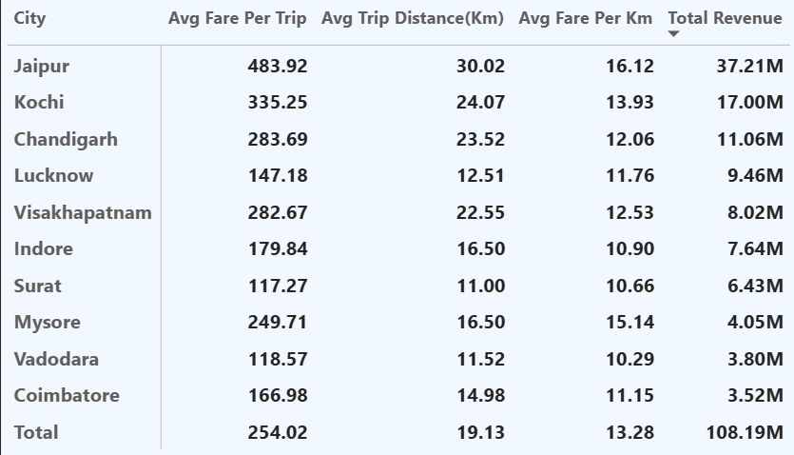
PA -2
Calculate the average fare per trip for each city and compare it with the city's average trip distance. Identify the cities with the highest and lowest average fare per trip to assess pricing efficiency across locations.
Jaipur is the Key revenue driver, generating ₹37.21M and contributing 34% of total revenue.
Jaipur, Kochi, Chandigarh together contributes 60% of overall revenue.
Only four cities - Jaipur, Kochi, Chandigarh, Visakhapatnam - exceed the average fare per trip of ₹254.02
Jaipur also has highest average fare per trip (₹483.92) & the longest average trip distance (30.02 km).
Mysore has high average fare per km (₹15.14) & solid average fare per trip (₹249.71), but underutilized with low total revenue (₹4.05M).
Surat showing lowest average fare per trip (₹117.27) & low fare per km (₹10.66).

Slide 10
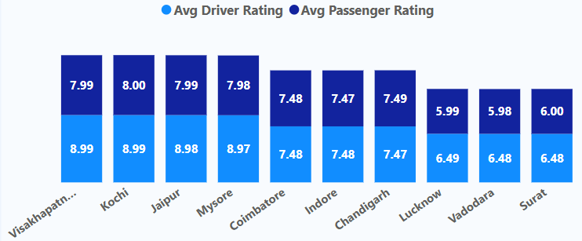
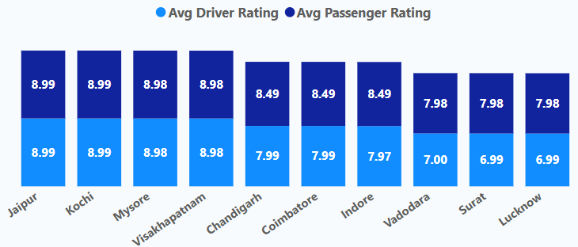
PA -3
Calculate the average passenger and driver ratings for each city, segmented by passenger type (new vs. repeat). Identify cities with the highest and lowest average ratings.
Repeated
New
(Jaipur, Kochi, Mysore, Visakhapatnam) shows high passenger & Driver rating in terms of New vs Repeated customers
(Lucknow, Surat, Vadodara) shows consistently low rating based on New vs Repeated customers

Slide 11
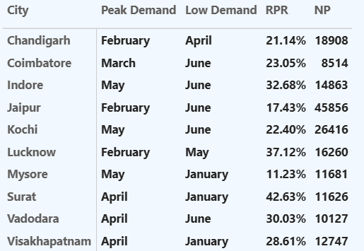
PA -4
For each city, identify the month with the highest total trips (peak demand) and the month with the lowest total trips (low demand).
Peak Trip Demand Months
February, April, May shows highest trip volumes across all the cities
Low Trip Demand Months
January, June has lowest trip demand across all the cities

Slide 12
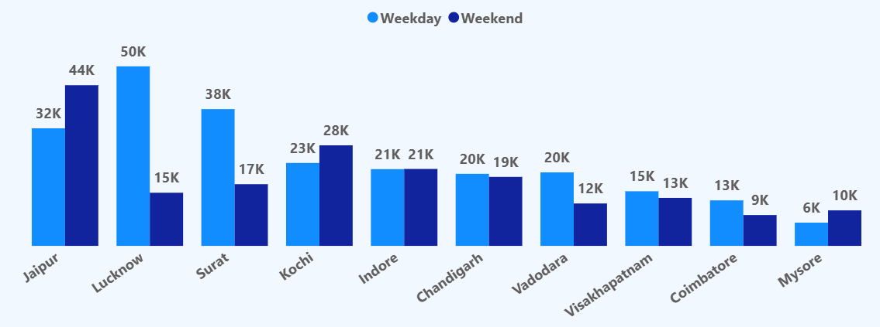
PA -5
Compare the total trips taken on weekdays versus weekends for each city over the six-month period. Identify cities with a strong preference for either weekend or weekday trips to understand demand variations.
Weekend Trend
Tourism Focused cities like Jaipur, Mysore, Kochi shows higher weekend demands
Weekday Trend
Business Focused cities like Lucknow, Surat, Vadodara,Coimbatore shows higher weekday demands

Slide 13
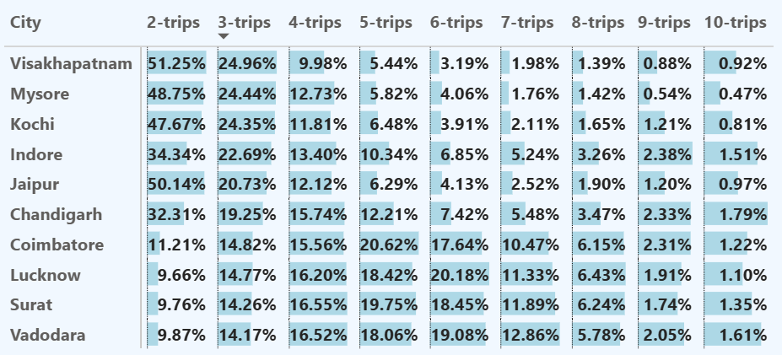
PA -6
Identify which cities contribute most to higher trip frequencies among repeat passengers, and examine if there are distinguishable patterns between tourism-focused and business-focused cities.
Jaipur, Kochi, Mysore, Visakhapatnam - show high 2-3 trip repeat rates, Retention drops drastically after the 3rd trip
Chandigarh maintains consistency - steady repeat frequency across the 2–8 trip range, indicating a highly reliable customer base.
Coimbatore, Lucknow, Surat, Vadodara dominate the 4–8 trip frequency segment, showing deeper market penetration & habitual usage patterns.
Business cities show stronger repeat behavior, while tourism cities drive volume but struggle with retention

Slide 14
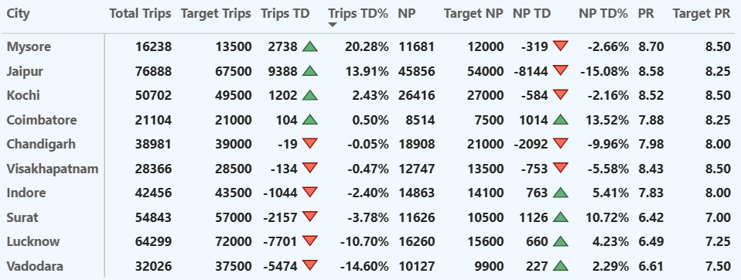
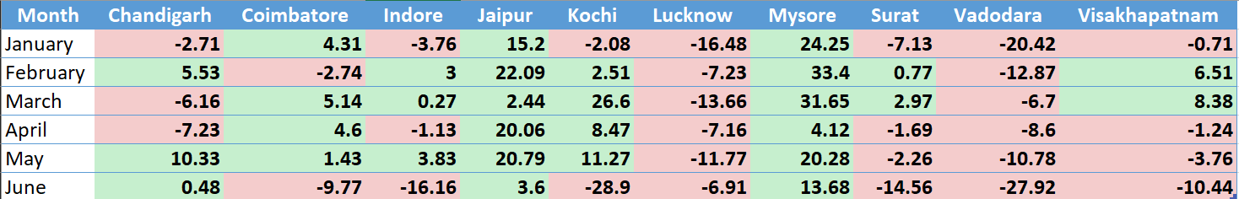
PA -7
For each city, evaluate monthly performance against targets for total trips, new passengers, and average passenger ratings. Determine if each metric met, exceeded, or missed the target, and calculate the percentage difference.

Slide 15
By Trips Performance
Top Performers: Mysore (+20.28%) – best overall trip performance | Jaipur (+13.91%)
Underperformers: Vadodara (-14.60%) – biggest shortfall | Lucknow (-10.70%)
By New Passenger Growth
Strong Growth Cities: Coimbatore (+13.52%) | Surat (+10.72%)
Weak Acquisition: Jaipur (-15.08%) – needs focus on new users | Chandigarh (-9.96%)
By Passenger Rating
Highest Rated Cities: Mysore (8.70) | Jaipur (8.58) | Kochi (8.52)
Low Rating Cities (Service Risk): Surat (6.42) | Lucknow (6.49) | Vadodara (6.61)
Critical Attention Areas
Lucknow & Vadodara missed targets in every month → Immediate action required
Jaipur & Mysore are the only cities achieving trip targets in all months → Best practice cities
January & June shows a huge decline across cities, highlighting the need for proactive seasonal demand planning.

Slide 16
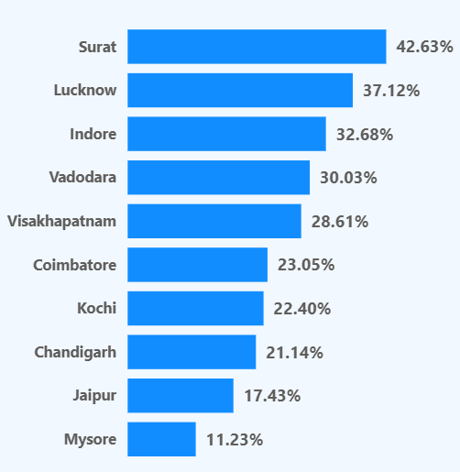
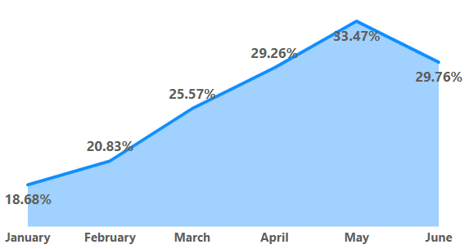
PA -8
Identify the top 2 and bottom 2 cities based on their RPR% to determine which locations have the strongest and weakest rates. Similarly, analyze the RPR% by month across all cities and identify the months with the highest and lowest repeat passenger rates.
Highest RPR Month : May(33.47%)
Lowest RPR Month : January(18.68%)
Higher RPR : Surat(42.63%) & Lucknow(37.12%)
Lower RPR : Jaipur(17.41%) & Mysore(11.23%)

Slide 17
Secondary Analysis

Slide 18

SA -1
Factors Influencing Repeat Passenger Rates (RPR)
Key Drivers of High Repeat Passenger Rates :
Trip Experience
Competitive Pricing
City Demographics
Socioeconomic and lifestyle patterns
Causes of Low Repeat Passenger Rates :
Seasonal and event-driven trips
Fare sensitivity during peak periods
Tourism cities → visitors, short stays, irregular travel - lower repeat usage

Slide 19

SA -2
Tourism vs Business Demand Impact
Impact of Tourism Seasons & Local Events :
Tourism cities such as Jaipur, Kochi, Mysore, and Chandigarh show - Strong weekend dominance
Demand spikes during: Festivals, Vacation periods, Cultural events
Sharp demand drops during off-season months (June, January)
In contrast, business cities maintain stable weekday demand, regardless of seasonality.
Marketing Strategy :
Festival-based ride offers
Airport / railway station promotions
Hotel & sightseeing packages
Weekend surge campaigns

Slide 20
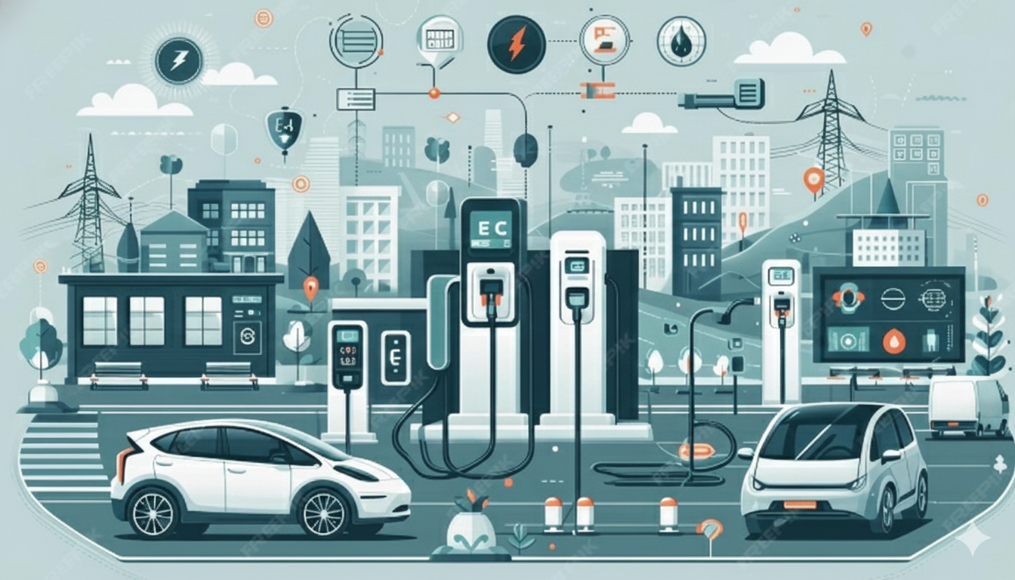
SA -3
Emerging Mobility Trends & GOODCABS’ Adaptation
Emerging Mobility Trends Impacting Cab Service Market in Tier-II Cities :
Electric Vehicles Adoption
Hybrid Vehicles Adoption
Green Energy Infrastructure
Benefits of Integrating EVs and Hybrids for Goodcabs :
Lower Operational Cost
Enhance long-term competitiveness
Improve brand perception

Slide 21

SA -4
Partnership Opportunities with Local Businesses
High-Potential Partnership Segments :
Hotels & Resorts (tourism cities)
Malls & Commercial Hubs (business cities)
Event venues & convention centers
Airports & railway stations
Corporate offices & IT parks
Business Impact of Partnerships :
Guaranteed demand inflow
Increased repeat usage
Improved brand visibility
Enhanced customer trust

Slide 22

SA -5
Data Collection for Enhanced Data-Driven Decisions
Customer Behavior Data :
Booking time patterns
Cancellation reasons
Promo usage & response
Operational Efficiency Data :
Driver idle time
Ride acceptance rate
Trip completion delays
Surge pricing impact
Driver availability by time slot

Slide 23

Ad-hoc Requests :
Analyzed ad-hoc business requests by writing SQL queries on the provided trips_db and target_db datasets to extract relevant insights.
Export query results and loaded datasets into Excel, creating separate, well-organized sheets for each business requirement.
Developed clean, readable, stakeholder-friendly Excel reports, ensuring ease of interpretation for non-technical users.

Slide 24
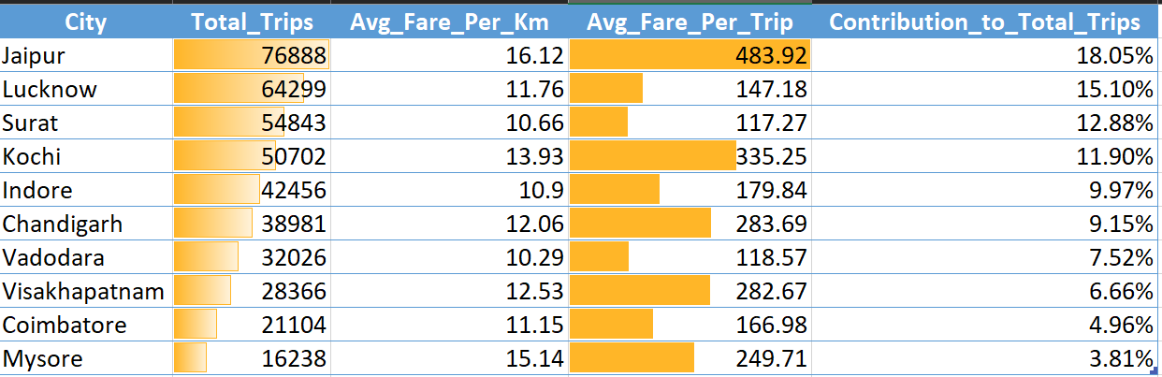
AR -1
City-Level Fare and Trip Summary Report
Generate a report that displays the total trips, average fare per km, average fare per trip, and the percentage contribution of each city's trips to the overall trips. This report will help in assessing trip volume, pricing efficiency, and each city's contribution to the overall trip count.

Slide 25
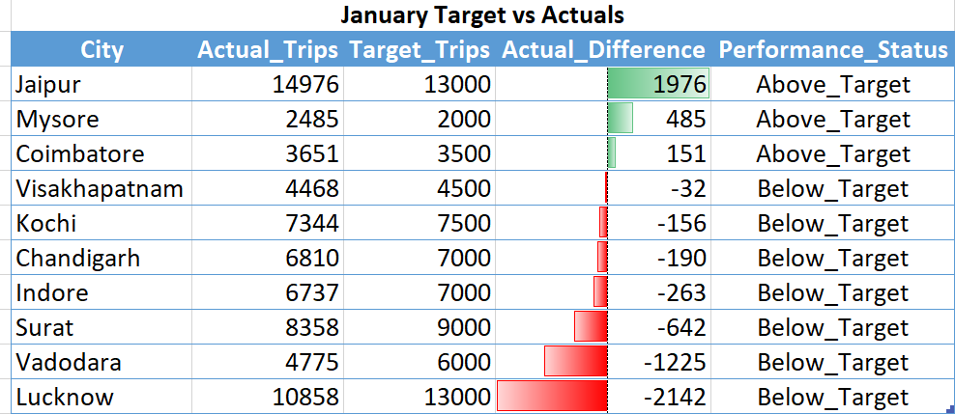
AR-2
Monthly City-Level Trips Target Performance Report
Generate a report that evaluates the target performance for trips at the monthly and city level. For each city and month, compare the actual total trips with the target trips and categorise the performance as follows:
If actual trips are greater than target trips, mark it as "Above Target".
If actual trips are less than or equal to target trips, mark it as "Below Target".
Additionally, calculate the % difference between actual and target trips to quantify the performance gap.

Slide 26
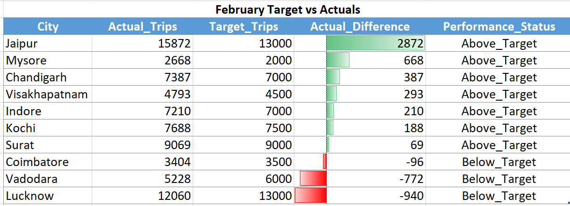
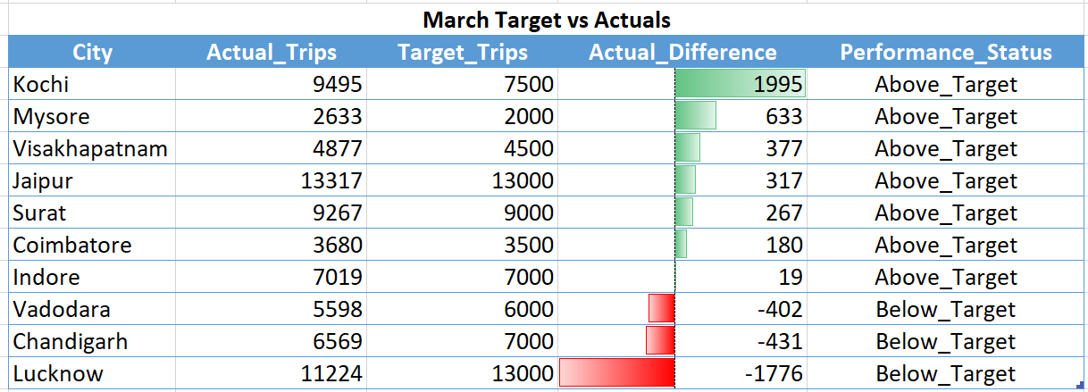

Slide 27
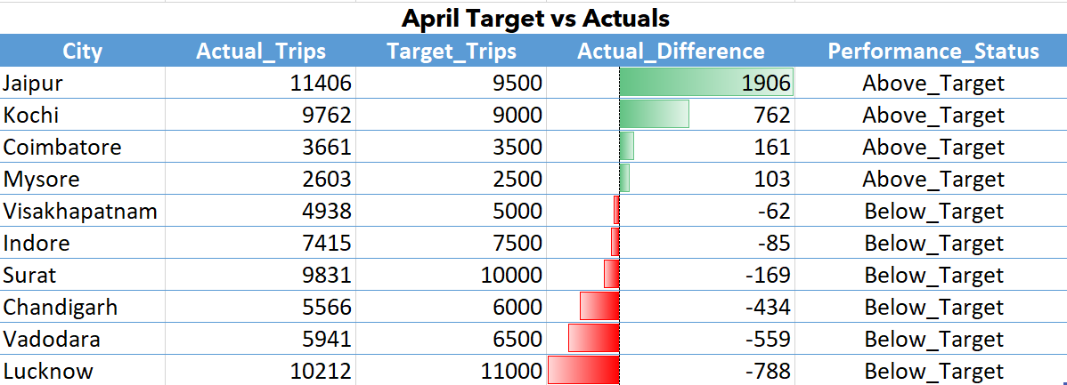
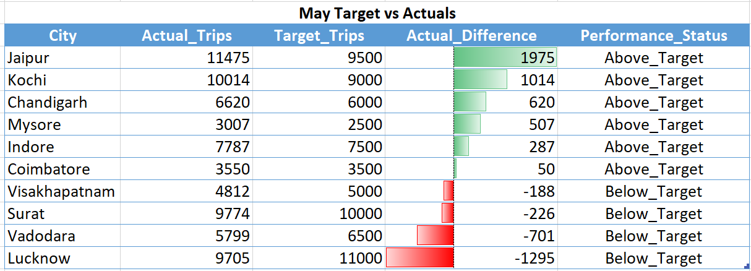

Slide 28
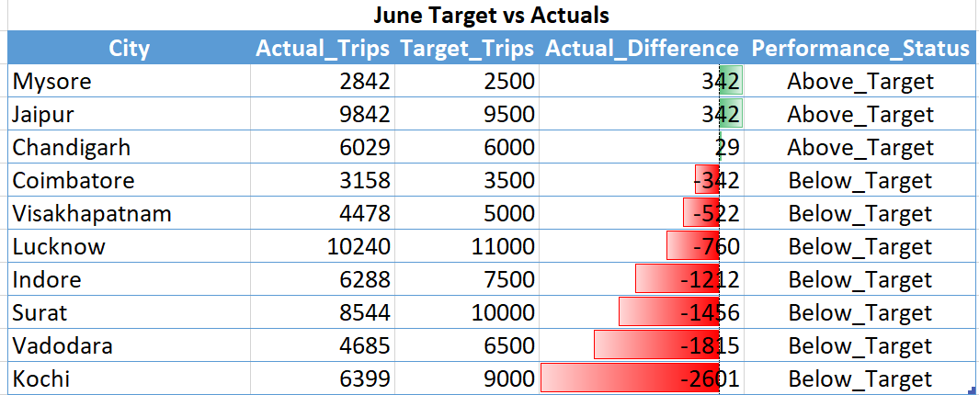

Slide 29
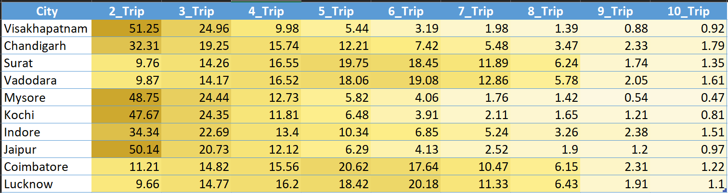
AR -3
City-Level Repeat Passenger Trip Frequency Report
Generate a report that shows the percentage distribution of repeat passengers by the number of trips they have taken in each city. Calculate the percentage of repeat passengers who took 2 trips, 3 trips, and so on, up to 10 trips. Each column should represent a trip count category, displaying the percentage of repeat passengers who fall into that category out of the total repeat passengers for that city.
Fields: city_name, 2-Trips, 3-Trips, 4-Trips, 5-Trips, 6-Trips, 7-Trips, 8-Trips, 9-Trips, 10-Trips

Slide 30
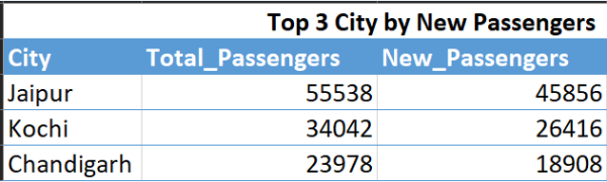
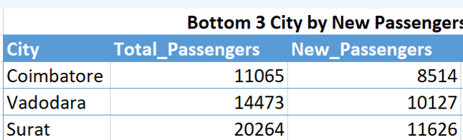
AR -4
Identify Cities with Highest and Lowest Total New Passengers
Generate a report that calculates the total new passengers for each city and ranks them based on this value. Identify the top 3 cities with the highest number of new passengers as well as the bottom 3 cities with the lowest number of new passengers, categorising them as "Top 3" or "Bottom 3" accordingly.

Slide 31
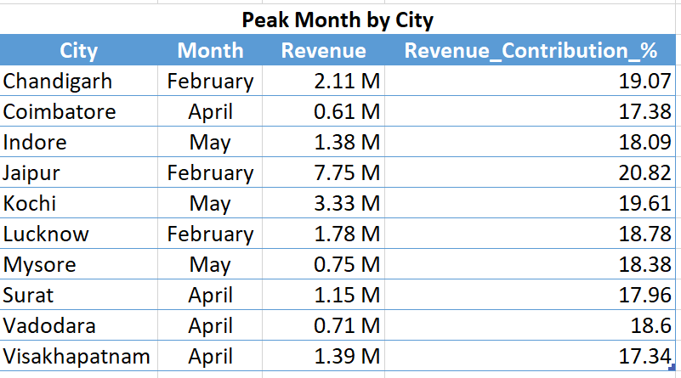
AR -5
Identify Month with Highest Revenue for Each City
Generate a report that identifies the month with the highest revenue for each city. For each city, display the month_name, the revenue amount for that month, and the percentage contribution of that month's revenue to the city's total revenue.

Slide 32
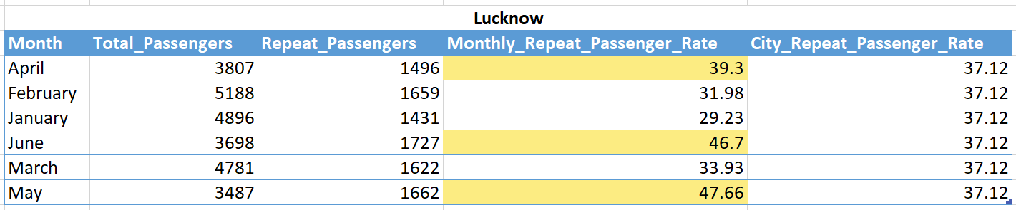
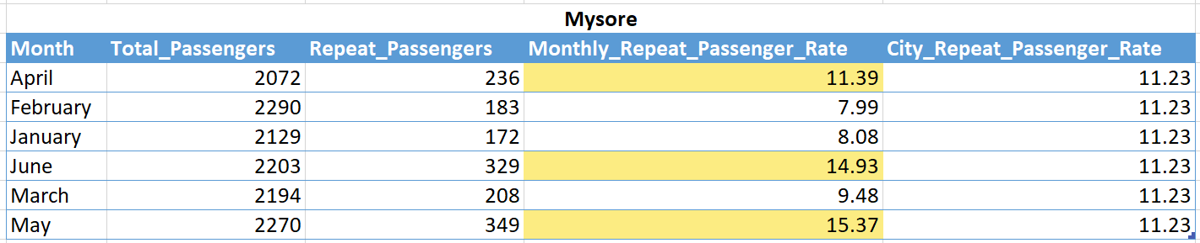
AR -6
Repeat Passenger Rate Analysis
Monthly Repeat Passenger Rate: Calculate the repeat passenger rate for each city and month by comparing the number of repeat passengers to the total passengers.
City-wide Repeat Passenger Rate: Calculate the overall repeat passenger rate for each city, considering all passengers across months.

Slide 33
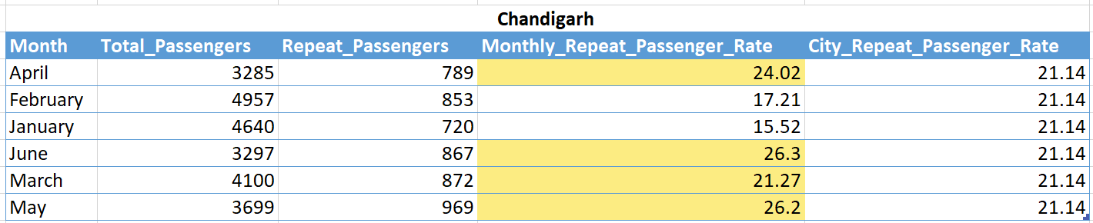
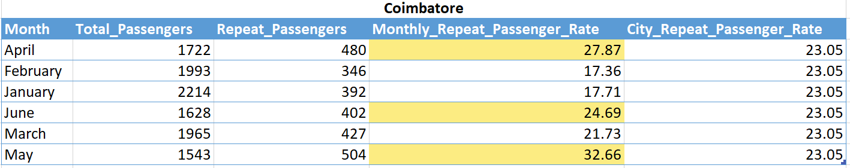
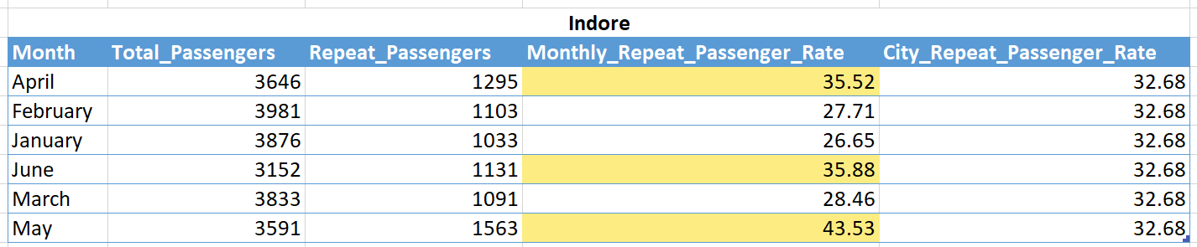

Slide 34
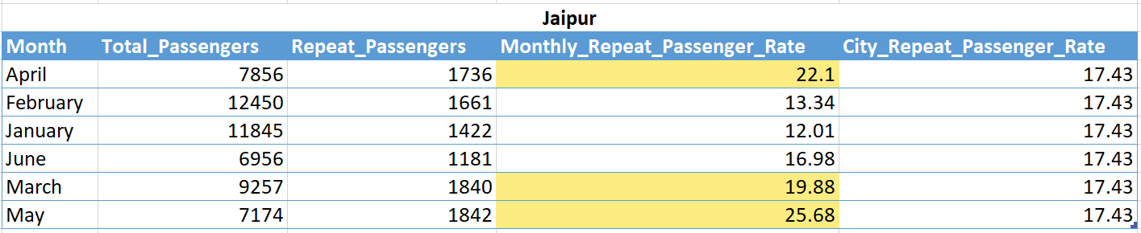
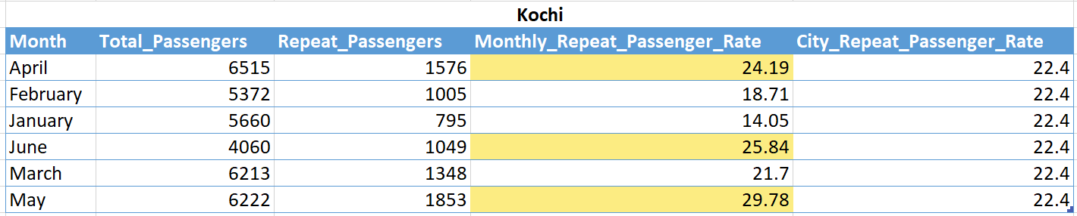
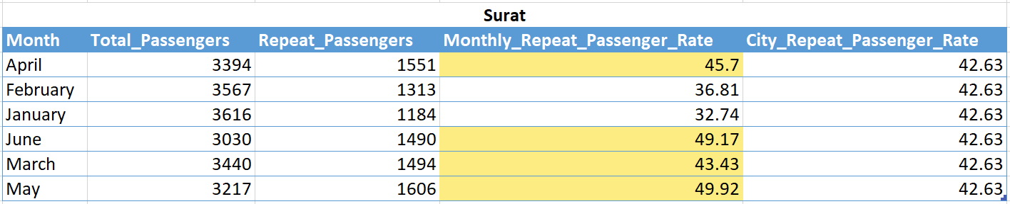

Slide 35
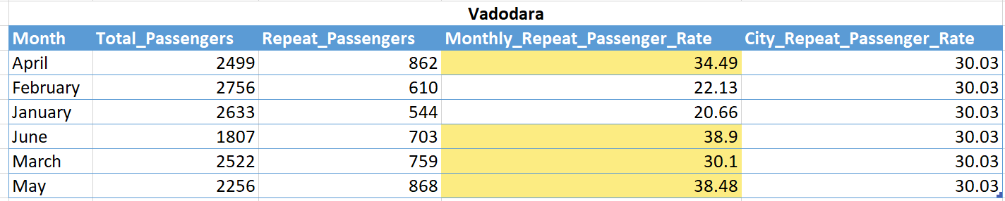
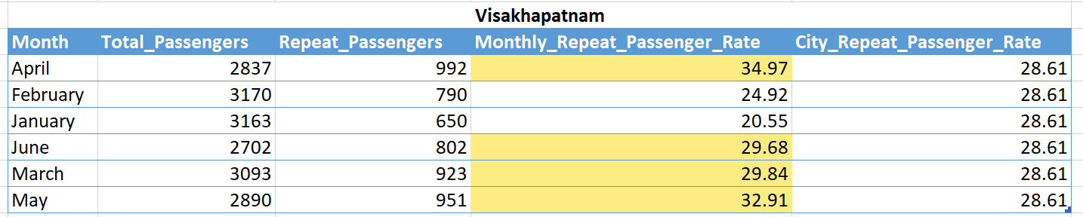

Slide 36

Recommendations
Retention is the biggest revenue contributor
Different strategies for different cities
Fix pricing inefficiencies
Service quality directly impacts repeat usage
Capitalize on festivals & events
Partnerships can unlock guaranteed demand
EV adoption as a long-term differentiator

Slide 37


